Slide 1
Communication
Breaking Language Barriers in Medicine™

Slide 2
What is communication?
Merriam-Webster: the act or process of using words, sounds, signs, or behaviors to express or exchange information or to express your ideas, thoughts, feelings, etc., to someone else
Oxford: the imparting or exchanging of information or news; the successful conveying or sharing of ideas and feelings

Slide 3
The interpreter’s Job:
“The basic function of the health care interpreter, as in other interpreter-mediated settings, is to provide a linguistic conversion from one language system into another in such a way that the original meaning is maintained”. *
*The Role Of The Health Care Interpreter: An Evolving Dialogue” April 2001

Slide 4
1994 Starting Point
The interpreter as conduit
The interpreter as manager of the cross-cultural/cross language mediated clinical encounter
The incremental intervention model
The interpreter as embedded in her cultural-linguistic community

Slide 5
The Incremental Intervention Model
The interpreter as a:
Conduit
Clarifier
Cultural Broker
Advocate

Slide 6
Interpreter as a Conduit
First things first
Interpret always in the first person
Refer to yourself using the 3rd person as in “the Interpreter…”
Interpret everything that is said
  Be accurate

Slide 7
Accuracy and Completeness
SUCH AN EASY CONCEPT!

Slide 8
Or is it?
In a Medical encounter:
  The Interpreter is part of a team looking out for the well being of the patient and…
  Should not be a passive party

Slide 9
Being Accurate
  Fidelity may require negotiated explanations
  Interpreter may have to resolve cultural differences between parties
  Must be transparent at all times
  Must never speak for any of the parties
  What about gestures?

Slide 10
Conduit in the Medical Setting
Provider is ultimately responsible for patients understanding; i.e. same language
Interpreter must recognize that accurate communication requires:
  Equivalence of concepts
  Knowledge of Cultural Context
  Patient’s Background
  Medical Culture

Slide 11
Interpreter as a Clarifier
Don't rush to judgment!
Intervention is justified only when misunderstanding is occurring after appropriate linguistic conversion:
  Register
  No appropriate linguistic equivalent
  Patient’s level of education

Slide 12
Overcoming barriers
If clarification is needed, keep everyone in the loop:
Transparency
  Switch from 1st to 3rd person
  Inform parties about the purpose of your intervention
  Be brief

Slide 13
Overcoming Barriers
Use definitions
Paint word pictures
Adjust the register
Check for understanding
Suggest appropriate register use by provider
Return to Conduit Role

Slide 14
Interpreter as an Advocate
Interpreter acts on behalf of the patient
Outside the medical interaction
Help deal with systemic barrier only:
  Insurance
  Medicaid
  Prescription Filling
  Access to Diagnostic Providers

Slide 15
Interpreter as a Cultural Broker
If communication is clearly failing due to:
Cultural
Religious
Social beliefs regarding Illness and Cures
Provide both parties with cultural information to promote understanding of the message.
Return to Conduit Role

Slide 16
What’s my role
ADVOCATE
CULTURAL BROKER
CLARIFIER
CONDUIT

Slide 17
So you want to be an Interpreter?

Slide 18
Interpreting Style
Are you:
  Intuitive
  Counter-intuitive

Slide 19
Agustin’s Golden Rule
Did you hear what you just said?

Slide 20
David Kolb’s Learning Cycle
Stages of the Learning Cycle.
Experiencing: Carry out the task without reflection, just intention.
Reflection: Stepping back from task & review what’s been done and experienced.
Conceptualization: Interpreting events noticed. Use theory for framing events.

Slide 21
DO I HAVE WHAT IT TAKES?
KNOWLEDGE
Language
Expertise
ABILITIES
SKILLS
Innate
Talent
Interpreting
Techniques

Slide 22
David Kolb’s Learning Cycle
Stages of the Learning Cycle.
Experiencing: Carry out the task without reflection, just intention.
Reflection: Stepping back from task & review what’s been done and experienced.
Conceptualization: Interpreting events noticed. Use theory for framing events.
Planning: Taking new understanding and deciding actions required to refine task.

Slide 23
Consecutive Interpretation
Improve your AIM
  Attend
    Sorry, you must pay

Slide 24
Consecutive is the Most Reliable
Form of Interpretation
Because the interpreter hears the complete thought before beginning to interpret

Slide 25
Consecutive
Patricia Michelsen-King
More attention focused on Meaning the better the Recall
Basic skills: Attend & Understand

Slide 26
Being there
Understanding Original is essential.
It’s not the words, it’s: The Meaning,
Ambiguity in language, context is everything
Linguistic and Extra-linguistic knowledge

Slide 27
Idioms
How does this help?
Understanding interpretation
  Intra-lingual interpretation
  Inter-lingual interpretation

Slide 28
“rem tene
verba sequentur”
Cato

Slide 29
“Grasp the meaning
And the words will Follow”
cato

Slide 30
Consecutive Interpretation
Improve your AIM
  Attend
    Sorry, you must pay
  Inscribe
    A picture is worth a 1000 words

Slide 31
Note taking
Take notes in the
Source Language

Slide 32
Note-taking
Not one correct way
Patricia Michelsen-King
Divide page in half.
  Take notes vertically
Make notes simple and concise
(Write main ideas, trigger words)
Draw, make your own symbols
Practice, practice, practice

Slide 33
Consecutive Interpretation
Improve your AIM
  Attend
    Sorry, you must pay
  Inscribe
    A picture is worth a 1000 words
  Memorize
    Chain it together

Slide 34
The Chain Method
“A chain is as strong as its weakest link”
Visualization
The Linking Rules:
  It is all about you
  Size does matter
  Go ahead be silly

Slide 35
Dissecting Consecutive
The formula is in the question
  Mental templates
The long answer: tell me about it
  Mental pictures “A chain is as strong as its weakest link”

Slide 36
Sight Translation
READING FOR CONTENT
  The source is the key
  What’s the big idea?
CHUNKING
  Let me break it down for you
DELIVERY
  Nice and easy

Slide 37
INTERPRET
TARGET
READ
READ
Ipso ludme serums
Iexus to maxims tau

Slide 38
Sight Translation Delivery Exercises
Reading aloud
Expanding
Compressing
Word/Meaning Substitution

Slide 39
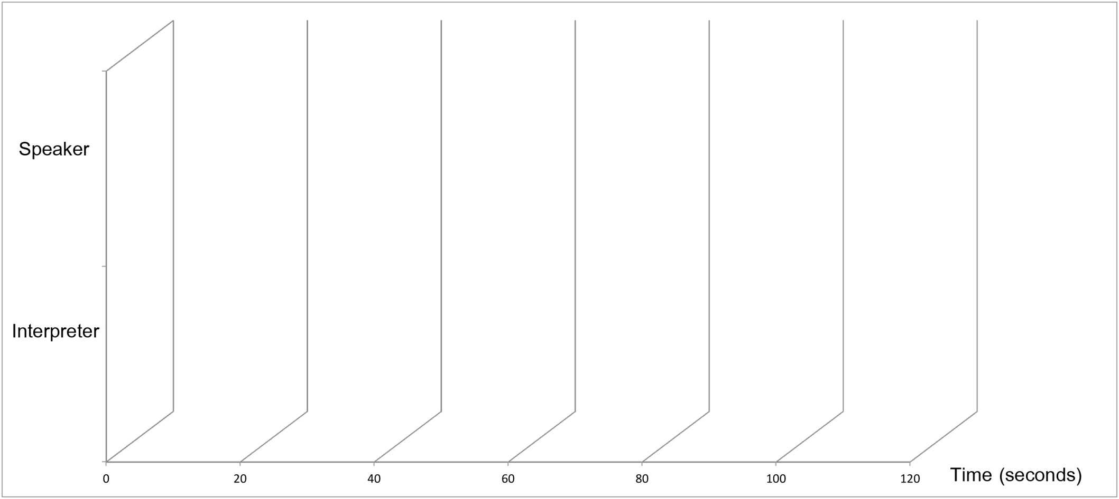
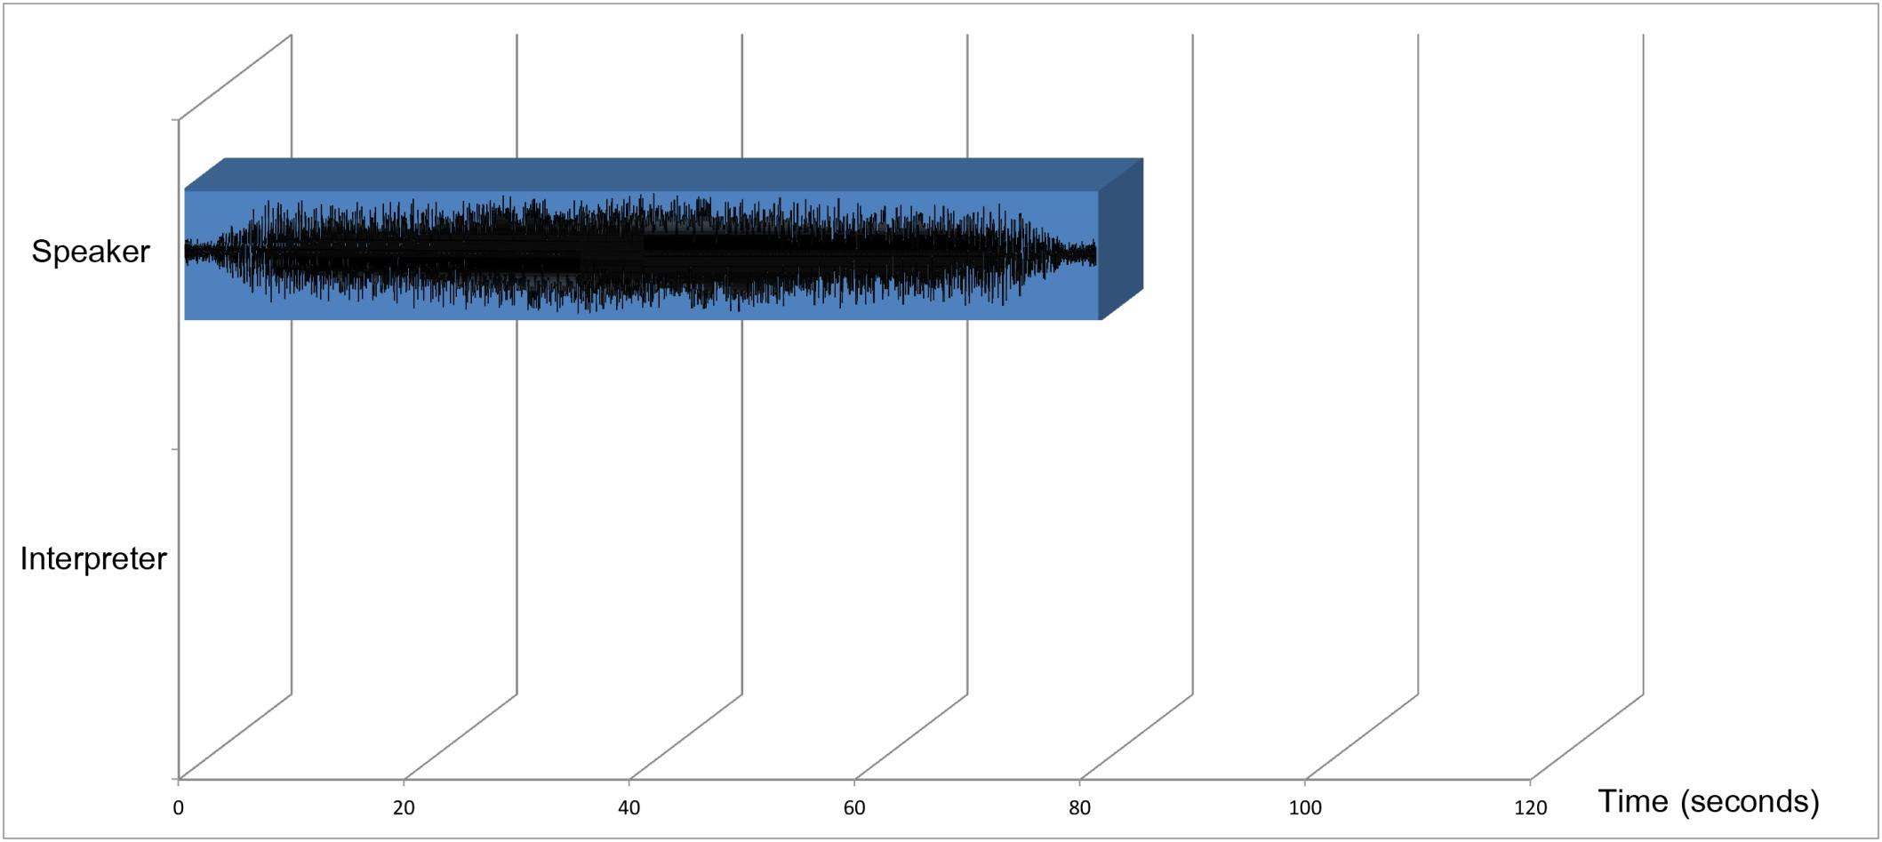
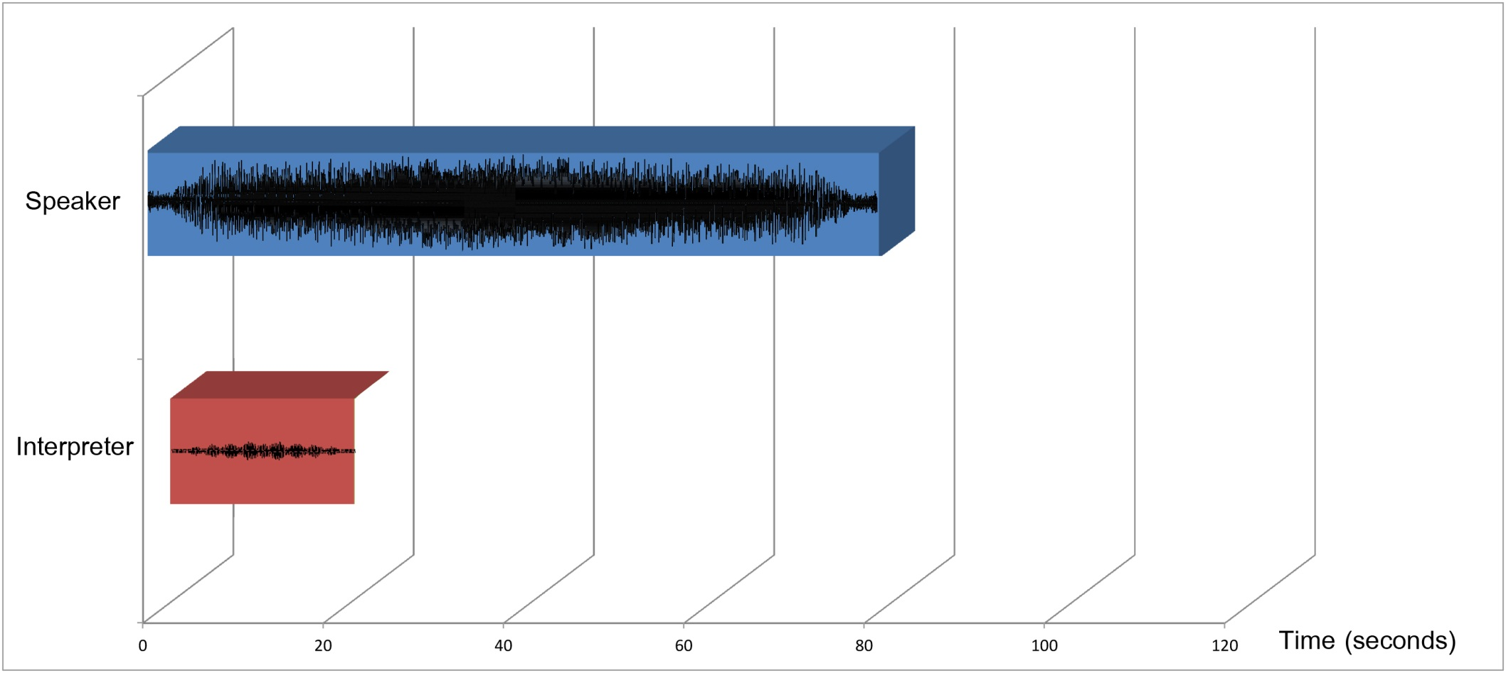
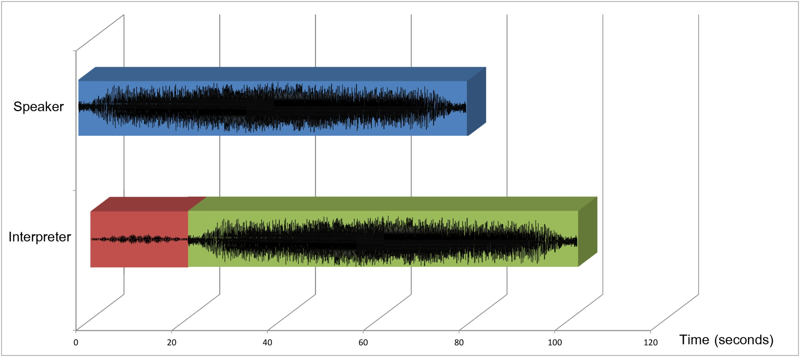

SIMULTANEOUS?

Slide 40
Shadowing
Target language
Select media
Increase “decalage”
Days:
  1. Shadow
  2. Shadow after 3 words
  3. Shadow after 5 words
  4 to 7. Shadow increasing number of words

Slide 41
www.interpreter-training.com

